Slide 1
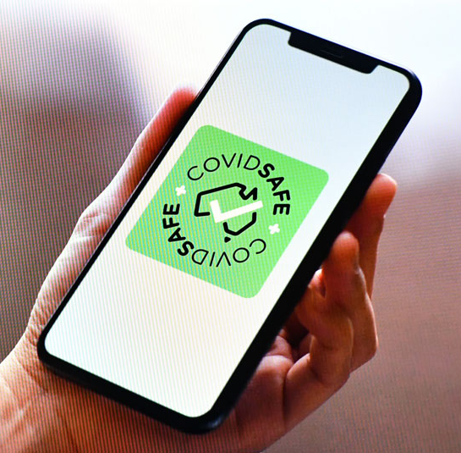
Public Perceptions of COVID-19 Tracking Technologies
Prof. Simon Dennis
Paul M. Garrett
Joshua White
In collaboration with:
Stephan Lewandowsky, Yoshi Kashima, Daniel Little, Amy Perfors, Lewis Mitchell, Nic Geard, & Martin Tomko
Notes:
One person to drive the slides unless we are going to use animaiton or mouse pointer.

Slide 2
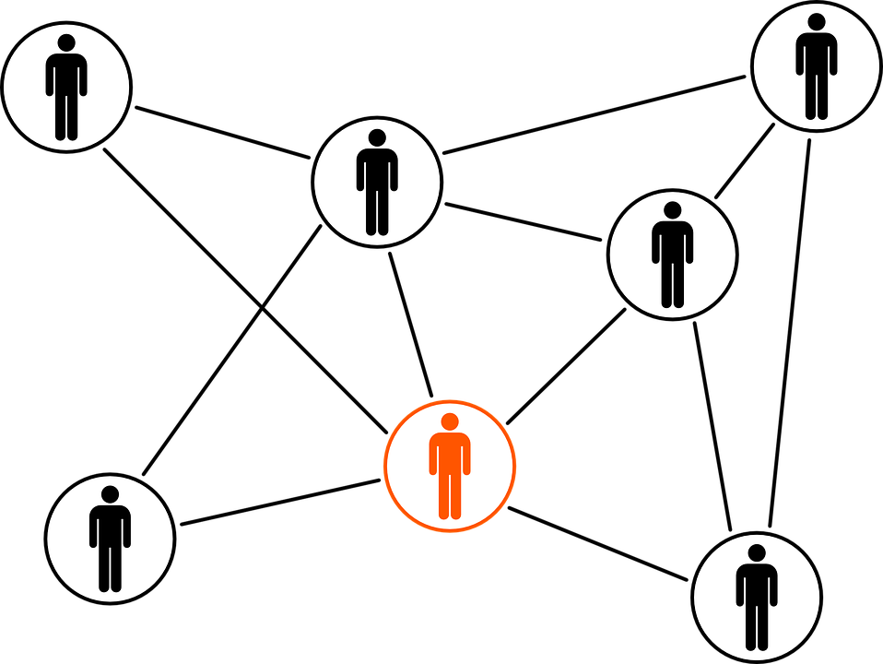
TODAY’S PRESENTATION
01
02
03
Introduction and Rapid Science
Professor Simon Dennis
Methods and Results
Dr Paul Garrett
Predicting Acceptance: Logit Models
Joshua White

Slide 3
INTRO &
RAPID SCIENCE
01
Professor Simon Dennis

Slide 4
Rapid Science
Mid 2018 LUMAS project starts
Social license of WIFI data
February 27th Survey released
March 21st Decided to adapt for COVID19
Contact by Stephan Lewandowsky
Contact by James McCaw
March 22nd Wrote funding proposals
March 24th Funded by philanthropic funds
March 27th Slack workspace created
April 3rd Ethics amendment approved
April 6th Wave 1 launched

Slide 5
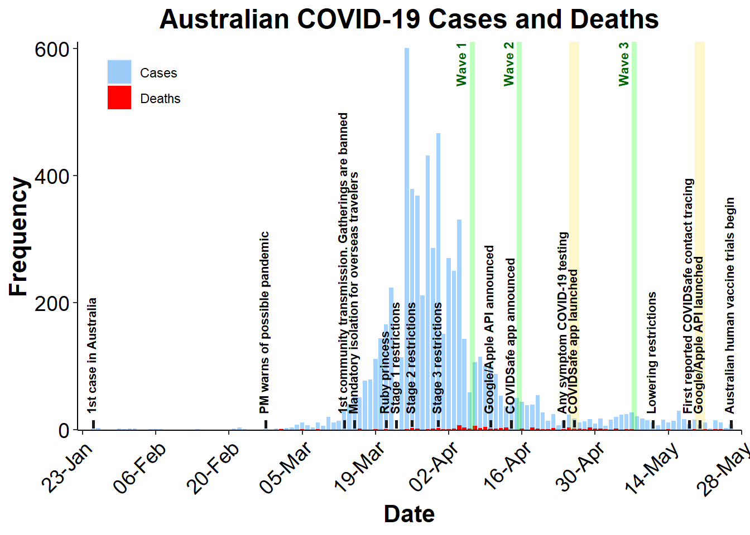

Slide 6
METHODS AND RESULTS
02
Paul M. Garrett

Slide 7
Method
Three Australian representative samples collected on April 6th, April 15th, and May 7th 2020.
Participants were recruited through the data collection platform Dynata and completed a 10 - 15 minute Qualtrics survey.
Samples were stratified by age, gender and state of residence as per the 2016 census.
In each wave of collection, we assessed participant’s:
Demographics
Impact from COVID-19
Perception of the COVID-19 pandemic
Attitudes towards one of three forms of mobile phone tracking for COVID-19
In Wave 3 we examined attitudes to a real world scenario: The COVIDSafe app.
Method

Slide 8
Tracking Scenarios
We assessed three hypothetical scenarios, and one real-world scenario, COVIDSafe.
Telecommunication Network Tracking - Mandatory tracking that uses phone networks to identify locations. Can be used by the Government to enforce fines for violating lockdown laws. (Waves 1 & 2; N = 801)
Apple/Google API - Voluntary tracking. Creates a Bluetooth contact registry & notifies you through an app if you were exposed to someone with COVID-19. Identification as COVID+ is voluntary & anonymous. (Wave 2; N = 383)
Government App - Same as above, except that data is accessible to the health department for manual contact tracing. (Waves 1 & 2; N = 806)
COVIDSafe Government App (Real World) - Same as Gov App, however, we highlight that easing social distancing restrictions depends in part on community uptake. (Wave 3; N = 449)
Method

Slide 9
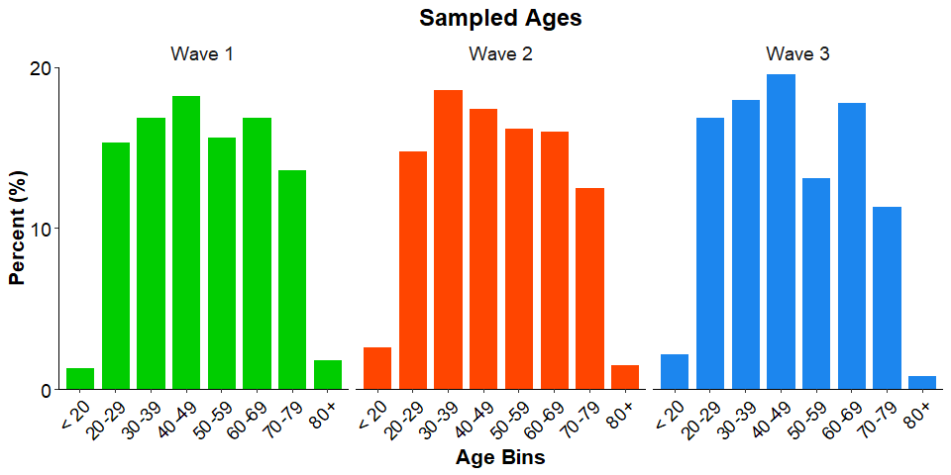
Demographics
Wave 1: N = 821. 48% Women.
Wave 2:
N = 1169. 49% Women.
Wave 3:
N = 449. 51% Women.
Phone Usage:
Wave 2 - 95%
Wave 3 - 93%
Demographics
M = 49 Years
SD = 17 Years
M = 48 Years
SD = 17 Years
M = 47 Years
SD = 17 Years
Notes:
Speaker notes….

Slide 10
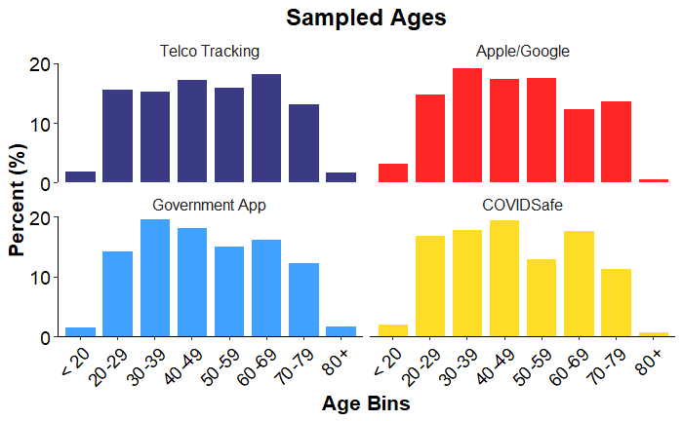
Demographics
Wave 1: N = 821. 48% Women.
Wave 2:
N = 1169. 49% Women.
Wave 3:
N = 449. 51% Women.
Phone Usage:
Wave 2 - 95%
Wave 3 - 93%
Demographics

Slide 11
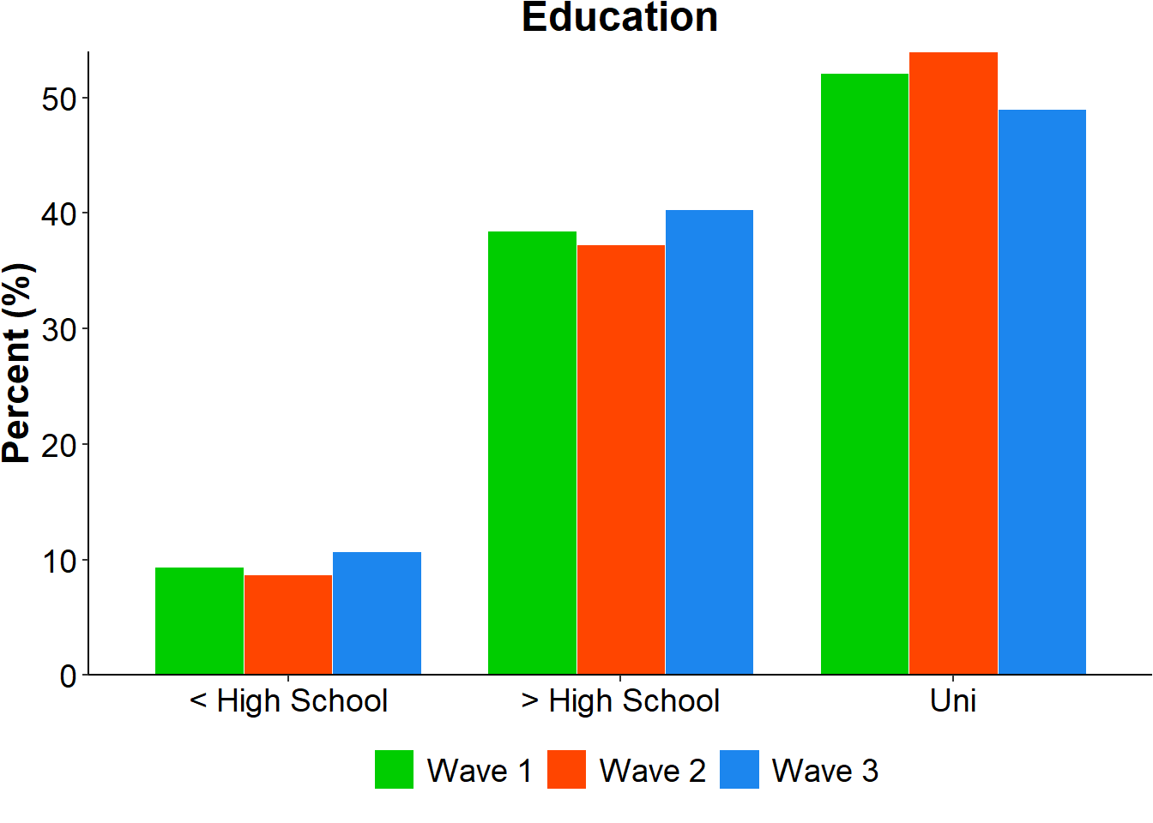
Demographics
Representative samples*
Education:
Bias towards university education.
*well, as close to a representative sample as we could manage.
Demographics

Slide 12
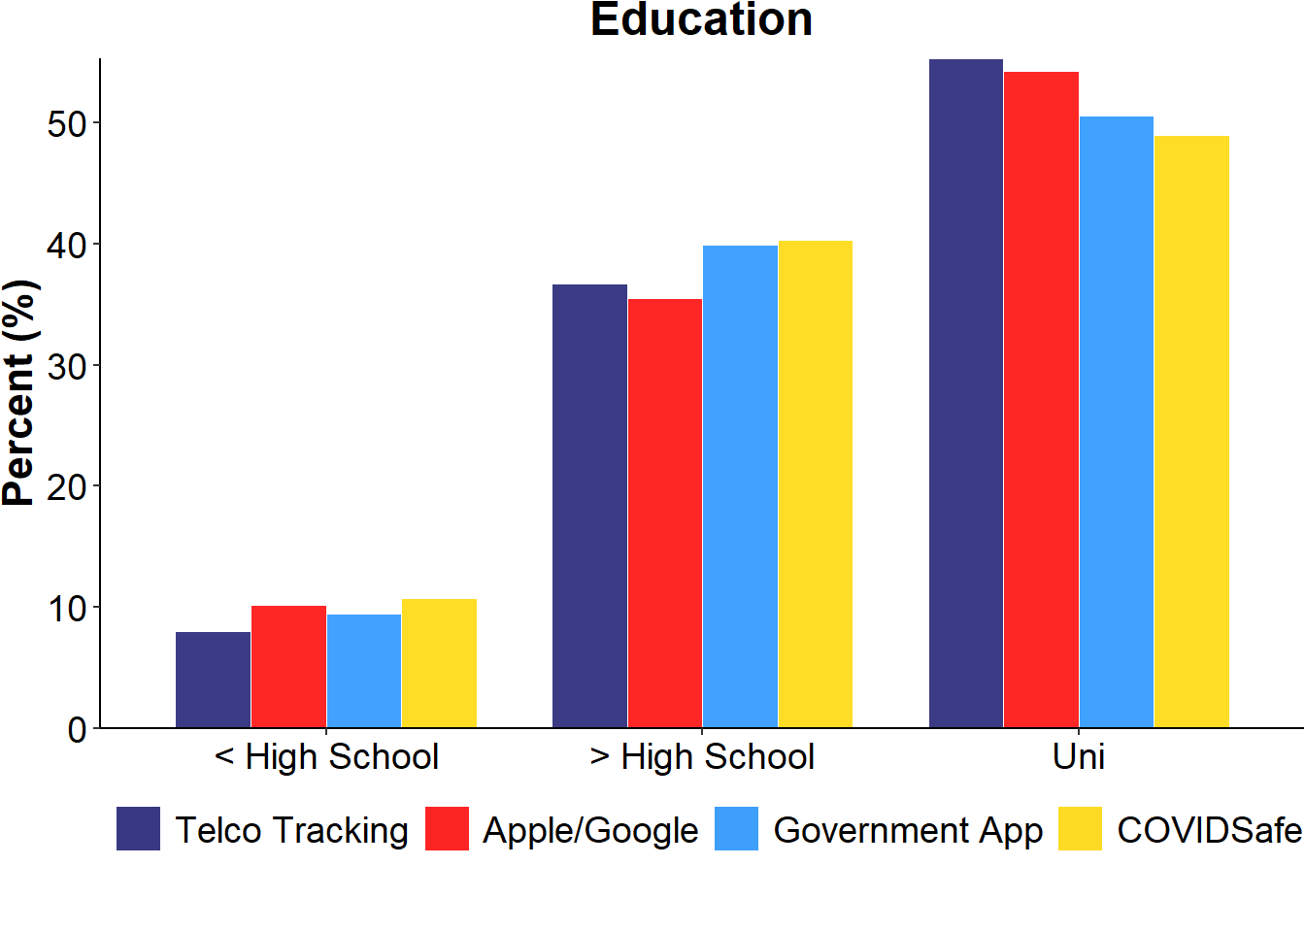
Demographics
Representative samples*
Education:
Bias towards university education.
*well, as close to a representative sample as we could manage.
Demographics

Slide 13
Impact of COVID-19
The percentage of self-reported COVID-19 cases increased slightly with each wave:
Wave 1: 0.2% (n=5)
Wave 2: 1% (n=11)
Wave 3: 1.5% (n=7)
Those who knew someone who had tested COVID + also increased:
Wave 1: 6% (n=49)
Wave 2: 8% (n=93)
Wave 3: 8.5% (n=38)
On average, 18% of individuals lost their jobs due to COVID-19.
Wave 1: 18% (n = 151)
Wave 2: 19% (n = 223)
Wave 3: 17% (n = 75)
Impact of COVID

Slide 14
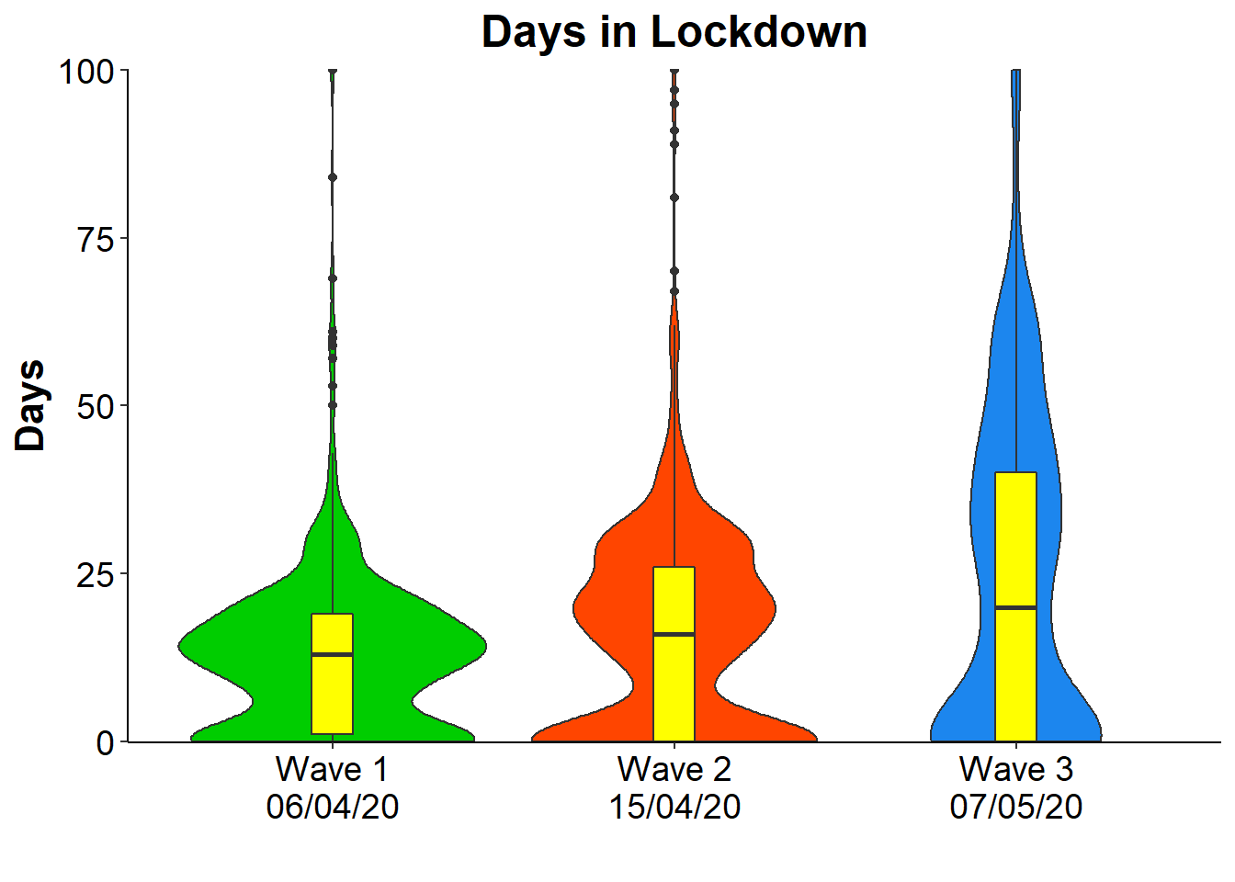
Impact of COVID-19
The average number of days in lockdown was 17 (SD = 17) days.
Days in lockdown extended with each wave of data collected:
Wave 1: 13 (SD = 12) days
Wave 2: 16 (SD = 15) days
Wave 3: 24 (SD = 25) days
However, the most frequently reported number of days in lockdown was zero days (25%):
Wave 1: 21%
Wave 2: 26%
Wave 3: 29%
Impact of COVID

Slide 15
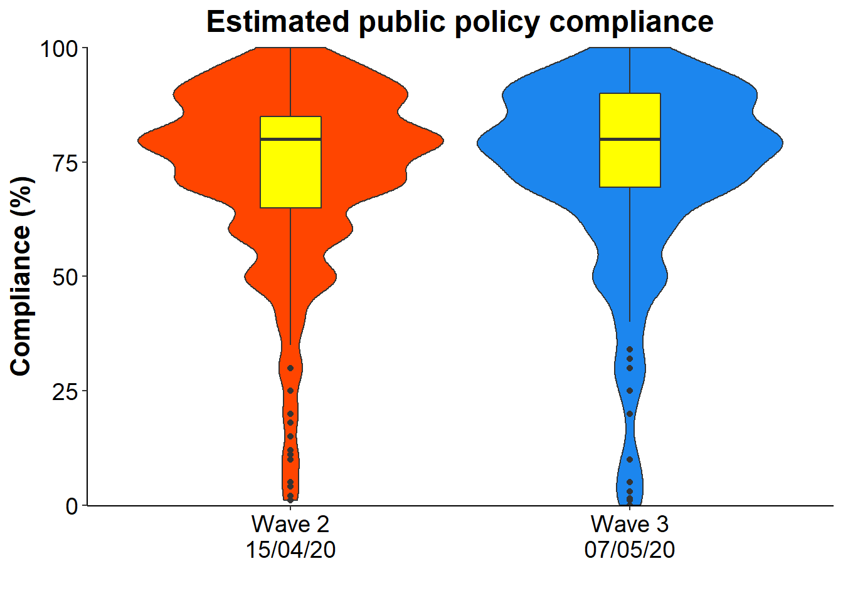
Impact of COVID-19
COVID-19 policies have included stay-at-home orders, a ban on public gatherings, & social distancing.
Of all those sampled...
73% thought other Australians were complying with Government policies.
Impact of COVID

Slide 16
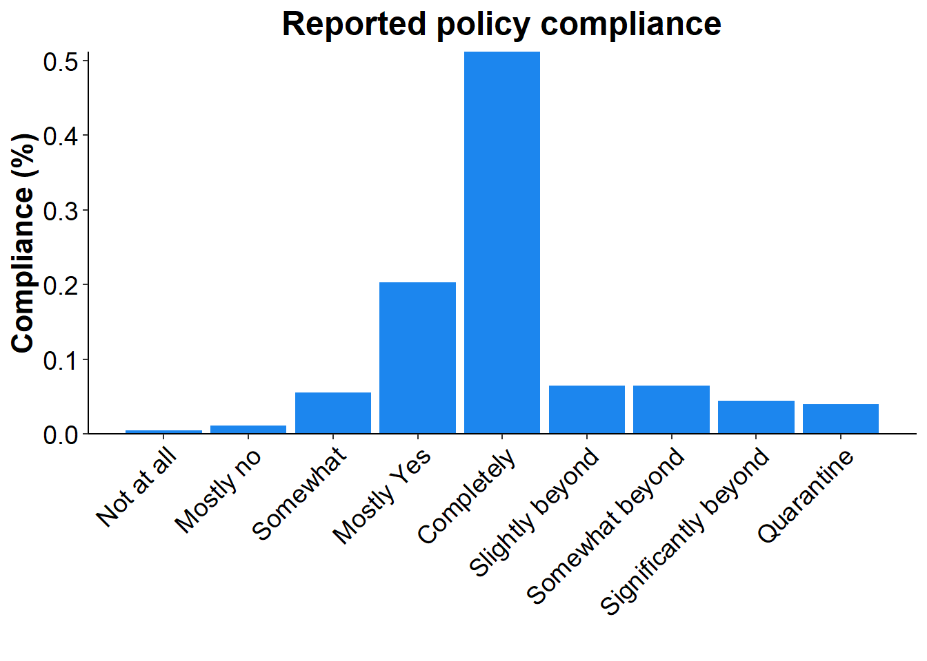
Impact of COVID-19
COVID-19 policies have included stay-at-home orders, a ban on public gatherings, & social distancing.
Of all those sampled...
73% thought other Australians were complying with Government policies.
And in Wave 3…
75% indicated they were complying with, or going beyond Governmental Policy recommendations.
Impact of COVID

Slide 17
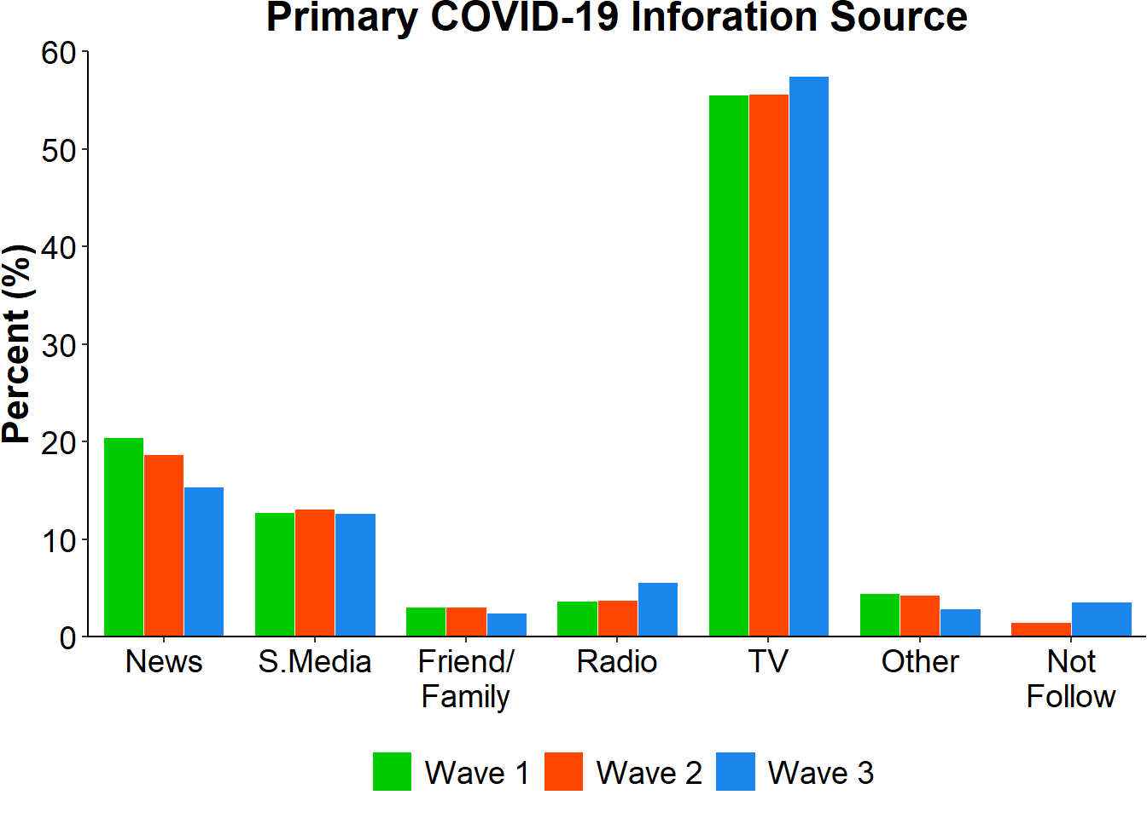
Perceptions of COVID
Perceptions of COVID

Slide 18
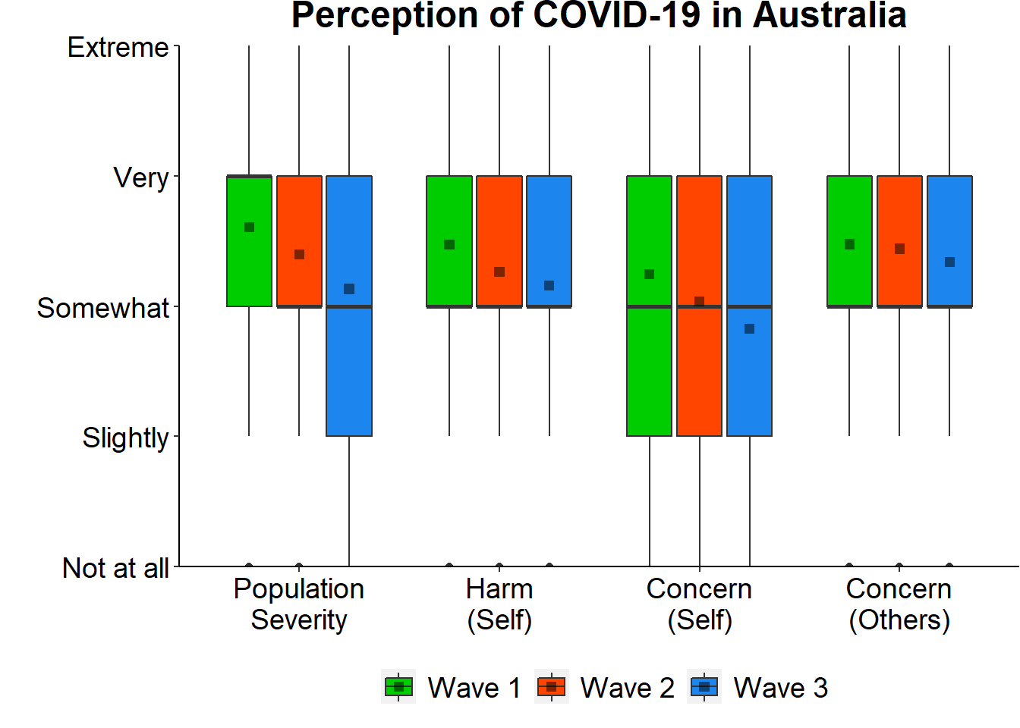
We asked participants to report: How severe they thought COVID-19 would be for the population?
How harmful it would be to their health?
And the concern they had about the virus for themselves and others around them.
Perceptions of COVID

Slide 19
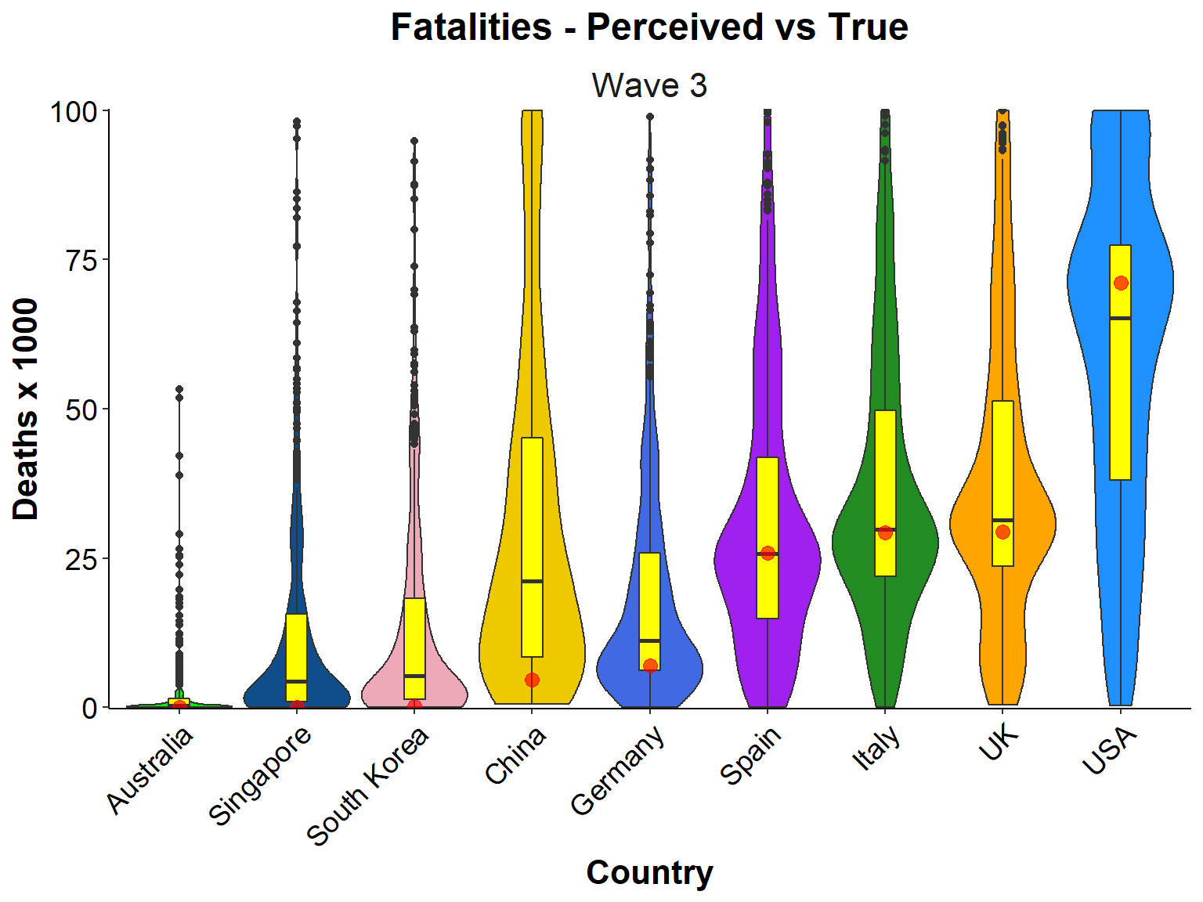
Estimated fatalities are generally higher than true fatalities.
Estimates for China are particularly poor...
...But why?
- Lack of information?
- Lack of trust in the provided information?
- Estimates anchored on population size?
Perceptions of COVID

Slide 20
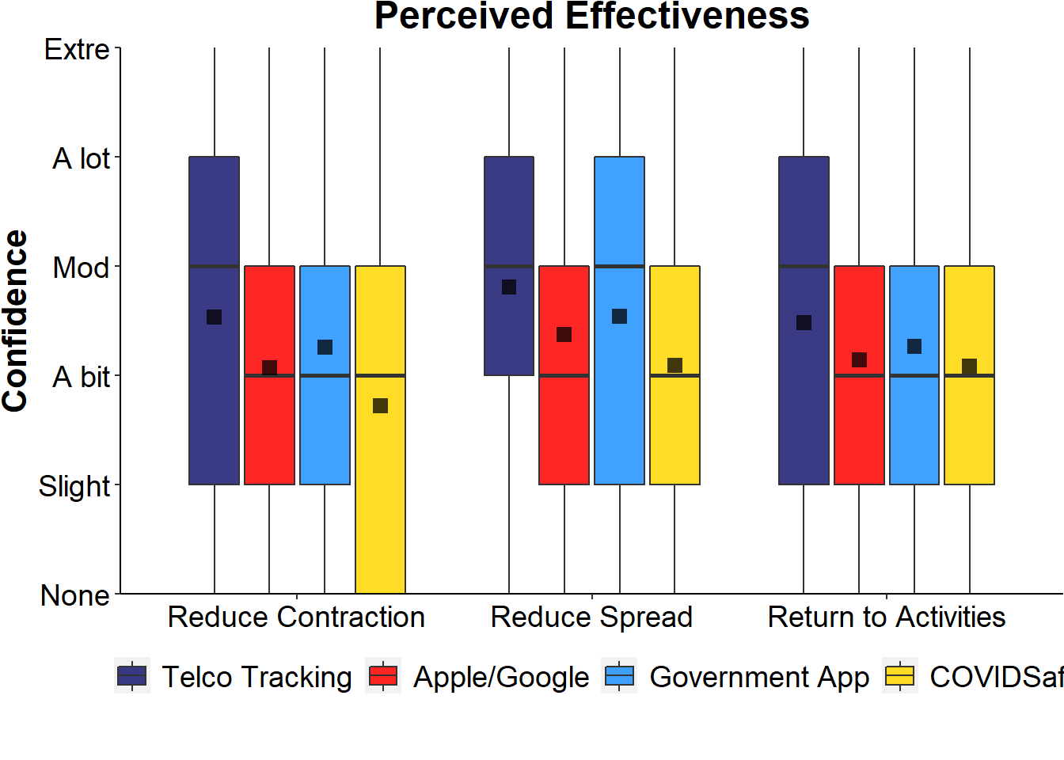
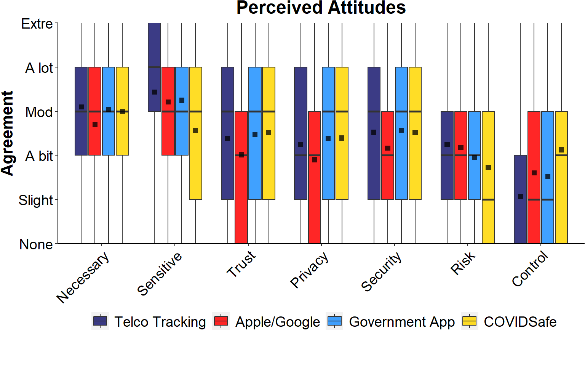
Network tracking perceived as most effective. It did not allow P’s to opt out.
Slight decline in effectiveness between hypothetical Gov App and COVIDSafe.
Possibly due to media exposure?
Perceived Effectiveness

Slide 21
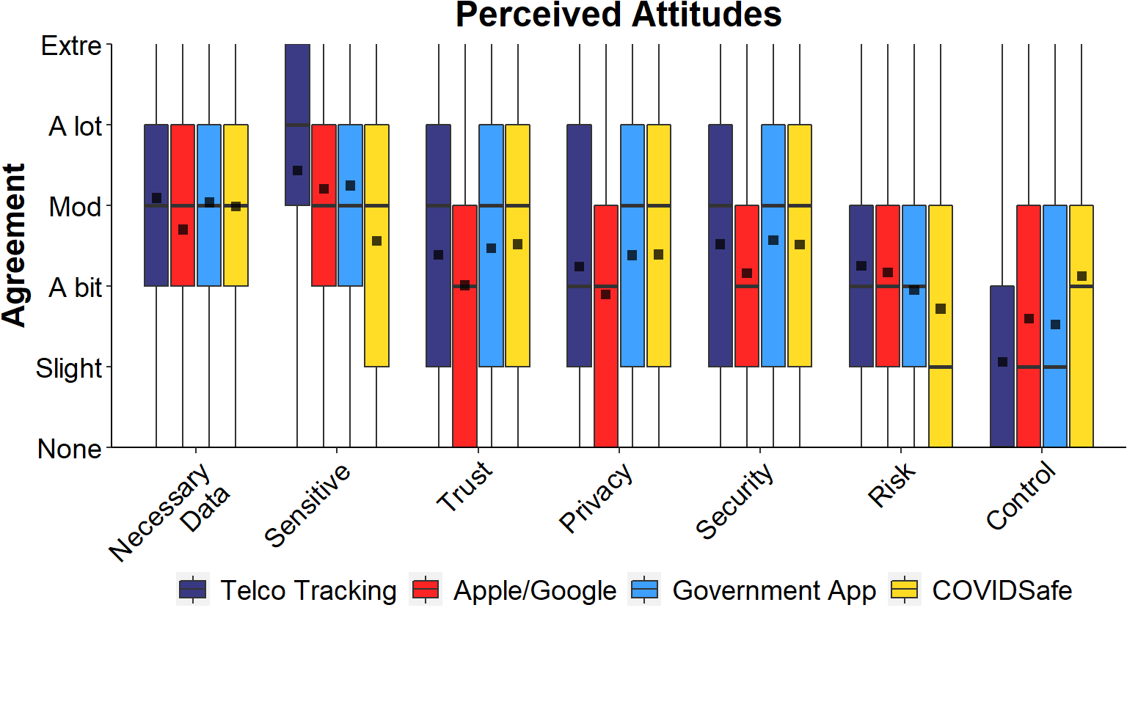
Attitudes to Tracking

Slide 22
Attitudes to Tracking

Slide 23
Attitudes to Tracking

Slide 24
Attitudes to Tracking

Slide 25
Acceptability of Tracking
After answering questions about each tracking method, participants were asked if the tracking scenario was acceptable. If no, conditional acceptability was assessed:
Sunset clause (All): would you accept tracking if the data had an expiry window of 6 months?
Network: Would you consent if the tracking had an option to opt-out?
Gov App: Would you consent to tracking if the data were stored locally on your phone?
COVIDSafe: Do you intend to download the app in the future?
COVIDSafe: Would you download the app if appropriate legislation were put in place?
Tracking Acceptability

Slide 26
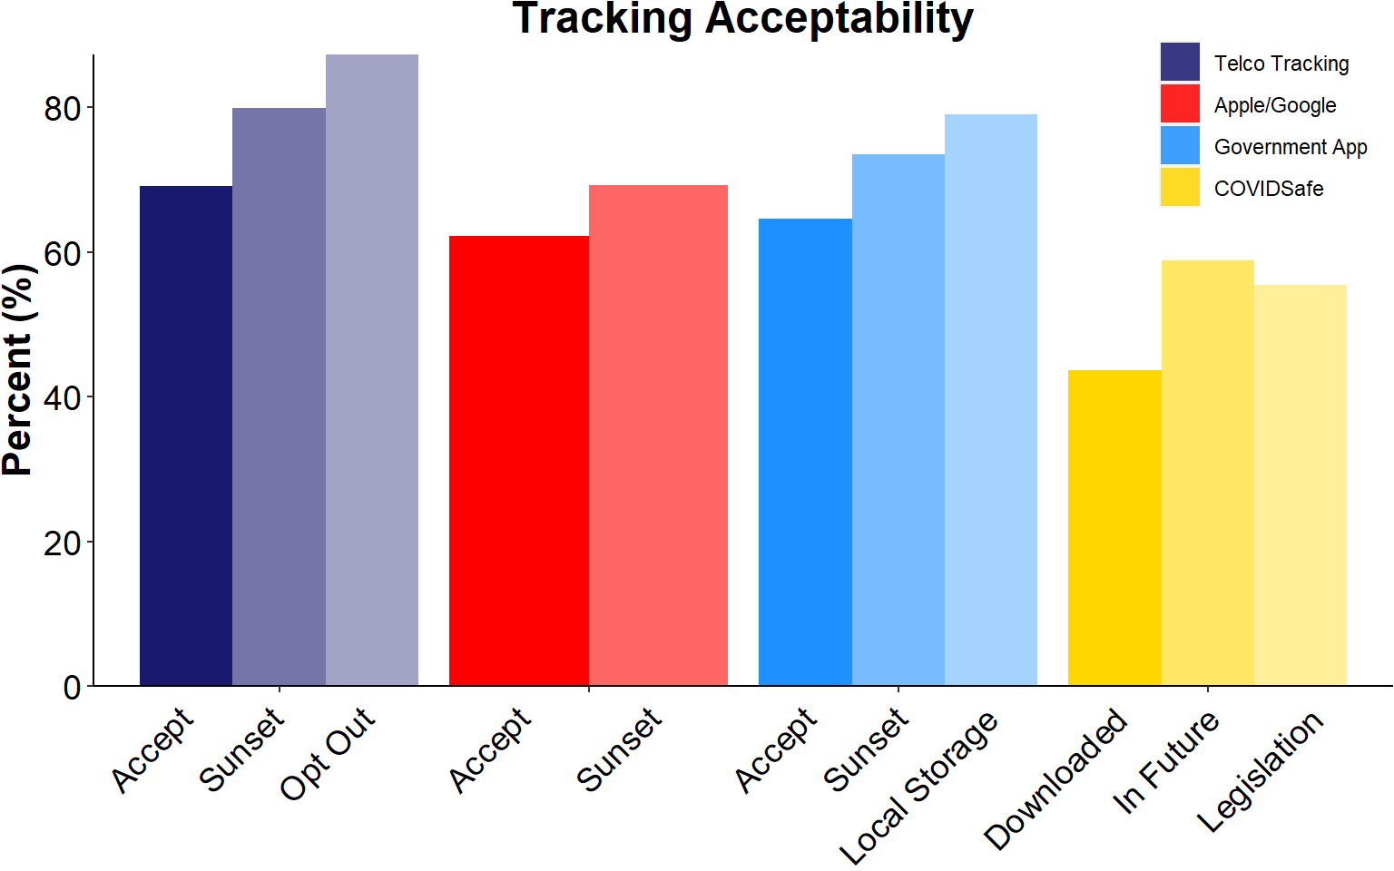
Tracking Acceptability

Slide 27
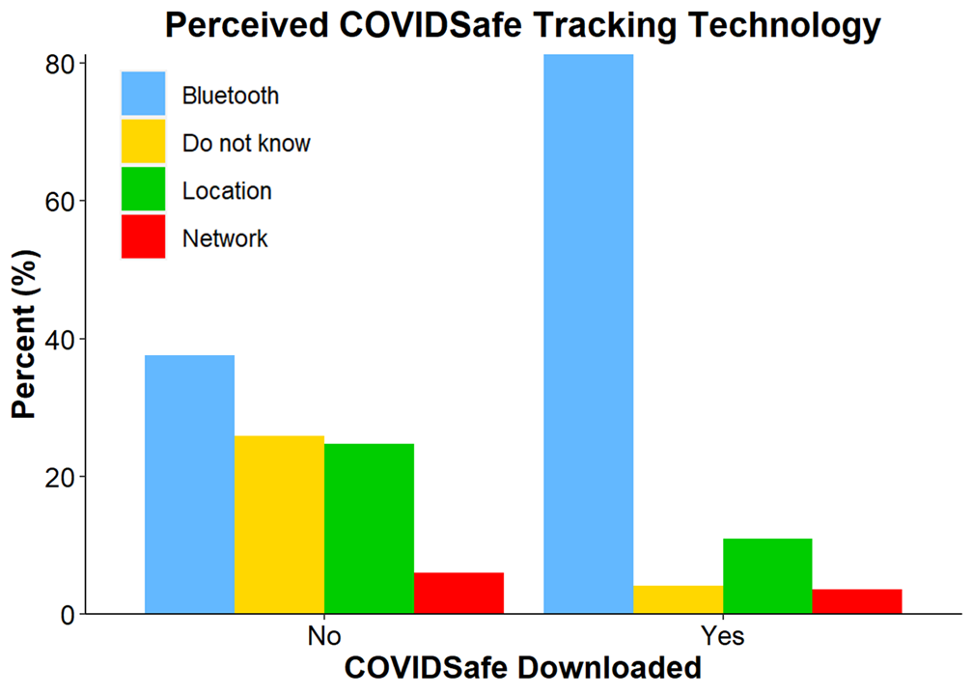
COVIDSafe - A Real World Scenario
COVIDSafe
44% downloaded the app, of which:
90% were registered users,
96% kept the app installed,
91% Bluetooth on when out and use the app as detailed* by Gov.
99% would upload their contact info if they tested as COVID+
58% tried to share the app with others.
*At this time the app did not make Apple users aware the app was not effective unless open on the front screen & unlocked.

Slide 28
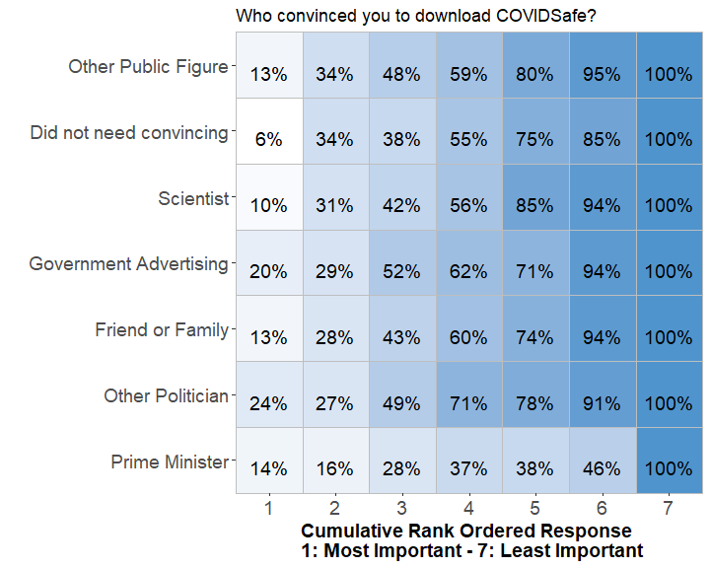
COVIDSafe
COVIDSafe
Participants rank-ordered the individual(s) who convinced you to Download COVIDSafe.

Slide 29
COVIDSafe
COVIDSafe
Participants rank-ordered the individual(s) who convinced you to Download COVIDSafe.

Slide 30
COVIDSafe
COVIDSafe
Participants rank-ordered the individual(s) who convinced you to Download COVIDSafe.
Gov Advertising & Other Politicians (not PM) were top-ranked.
By second selection, other Public Figures & Did not need convincing were best ranked.
The PM was poorly ranked overall.

Slide 31
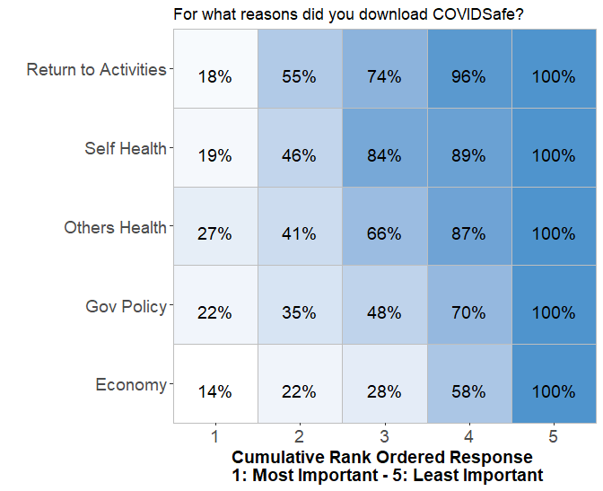
COVIDSafe
COVIDSafe
Rank-ordered reasons for downloading COVIDSafe.
Other’s health top ranked.
Economy worst ranked.
On second selection, returning to normal activities was best-ranked, then self- and others-health.

Slide 32
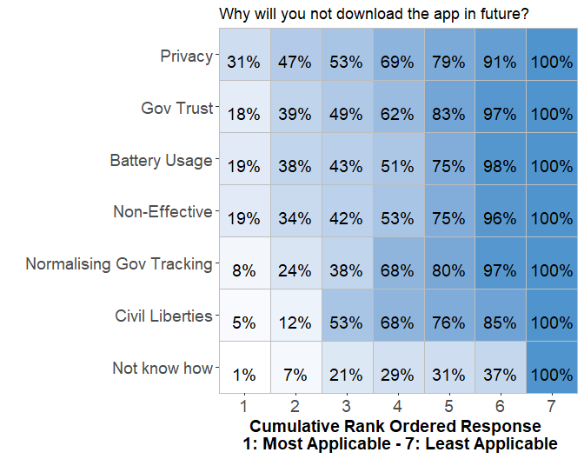
COVIDSafe
COVIDSafe
Rank-ordered reasons for not downloading COVIDSafe.
Privacy concerns were top-ranked.
Followed by tie between Gov Trust, Battery Usage, and a belief the app is not effective.
Not knowing how was lowest ranked, however, smartphone usage was 93%.

Slide 33
Summary
We assessed three [mostly] representative samples of the Australian public and determined:
The Impact COVID-19 has had on these people’s lives: 18% job loss with 1.5% infected and an average of 17 days in lockdown. 73% perceived compliance & 75% actual compliance with Gov Policy.
The Public’s Perception of the COVID-19 pandemic Estimated fatalities by nation were higher than true fatalities & TV main info source.
Public Attitudes towards mobile tracking methods to arrest the spread of COVID-19.
Network tracking most accepted, followed by Government App, then Apple/Google. There is a gap in attitudes & behaviour. 65% acceptance for a Gov App, but only 44% downloads.
Primary reason for downloading COVIDSafe was to return to normal activities, and to look after one’s personal health & the health of others.

Slide 34
PREDICTING ACCEPTANCE: LOGIT MODELS
03
Joshua White

Slide 35
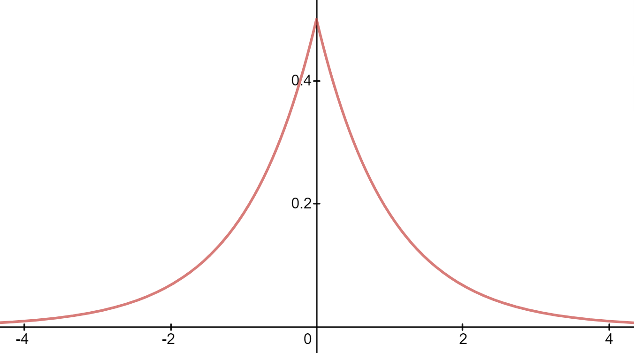
Predicting Acceptance: Method
A binary response variable was recorded for each scenario.
Hypothetical Telco Tracking: Is the governmental use of telecommunication data acceptable?
Hypothetical Apple/Google Bluetooth Tracking: Would you use an Apple/Google smartphone contact tracing capability?
Hypothetical Government App: Would you download and use a Government tracking app?
COVIDSafe App: Have you downloaded the COVIDSafe app?
Wave 2 data used for hypothetical scenarios, wave 3 for COVIDSafe scenario.
Each scenario was modeled separately as an additive function of:
Demographics
Perceptions and experience of COVID-19 pandemic
Perceptions of tracking effectiveness
Perceptions of tracking privacy
Ideology
Model Details
Likert ratings treated as interval data.
Categorical variables dummy coded with ‘treatment’ contrasts..
Bayesian logistic regression with Laplacian priors (location = 0, scale = 1 / range) over regression weights, and binomial likelihood
Posterior distributions approximated by MCMC (2 chains, 2000 iterations incl. 500 ‘burn-ins’) using the ‘R’ package brms (implemented through Stan))
Notes:
FOCUS ON WAVE 2. GOvapp and google API both options. Fair scenario.
Point out the three different type of questions
- hypothetical v real
- action (download and use) v is acceptable
- Government v Non-Government.
Get colours right.

Slide 36
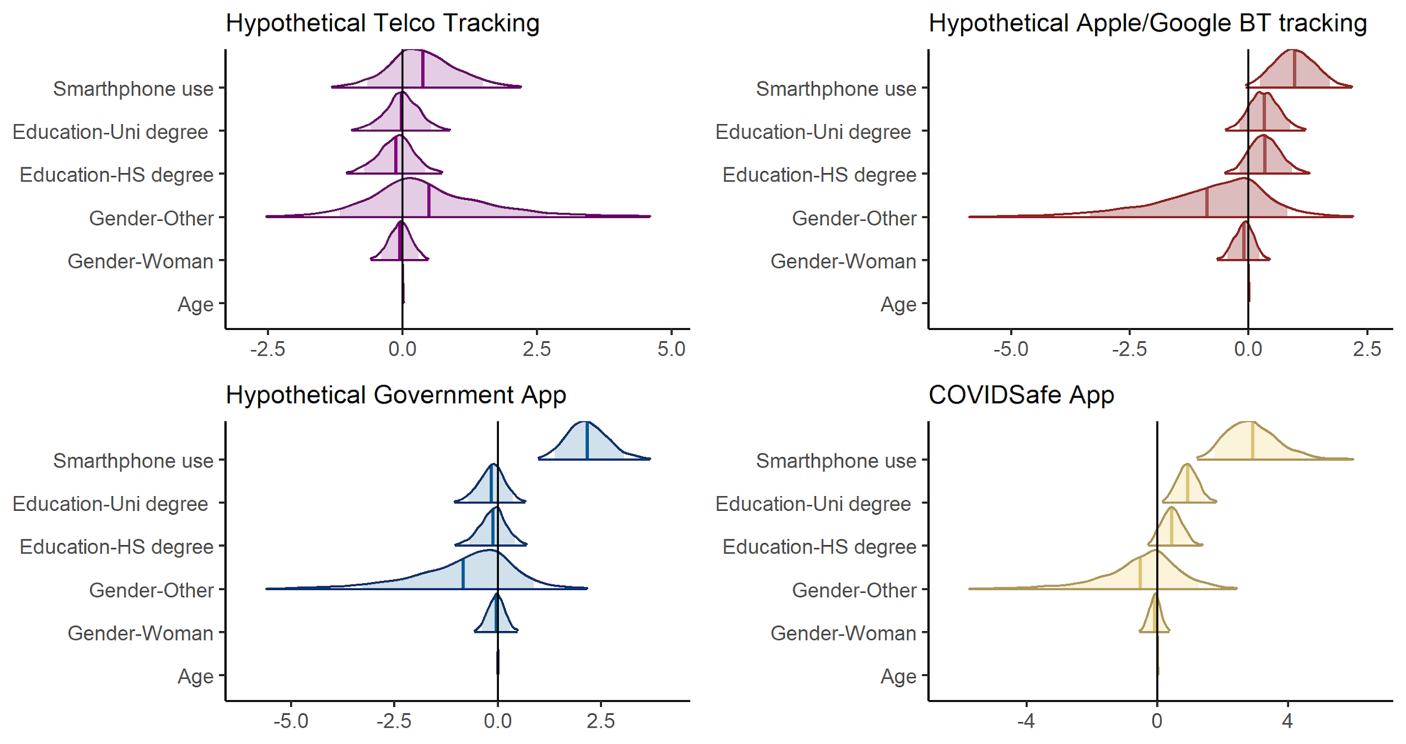
Predicting Acceptance: Demographics
Demographics
* .01 [90% HCI: 0, 0.03]
Notes:
Pattern: demographics by in large don’t effect
All scenarios (bar Telco tracking)smartphone use is a predictor (not suprising.
Otherwise, no demographic predictors.
COVID safe scenario -- the older you are the more likely to uptake
The more educated you are, the more likely the uptake.

Slide 37
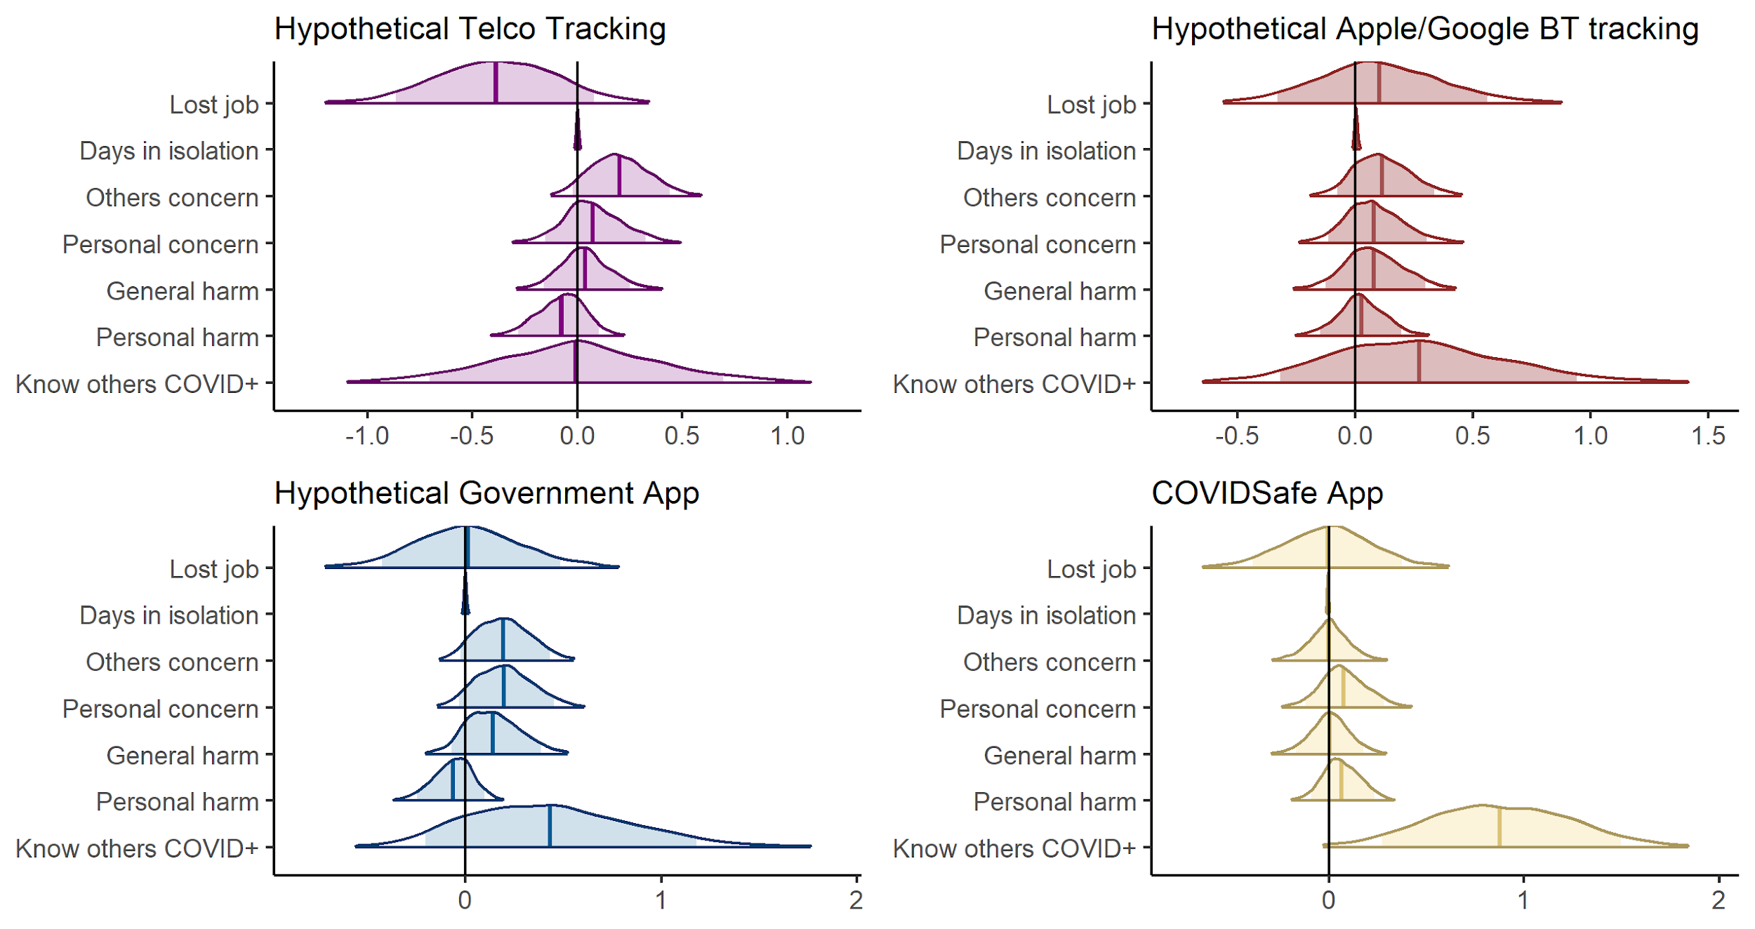
Predicting Acceptance: Perceptions and impact of COVID-19
Perceptions and Impact of COVID-19
Notes:
No strong/clear effects except - Those that know others tested positive to COVID much more likely to have downloaded COVIDSafe

Slide 38
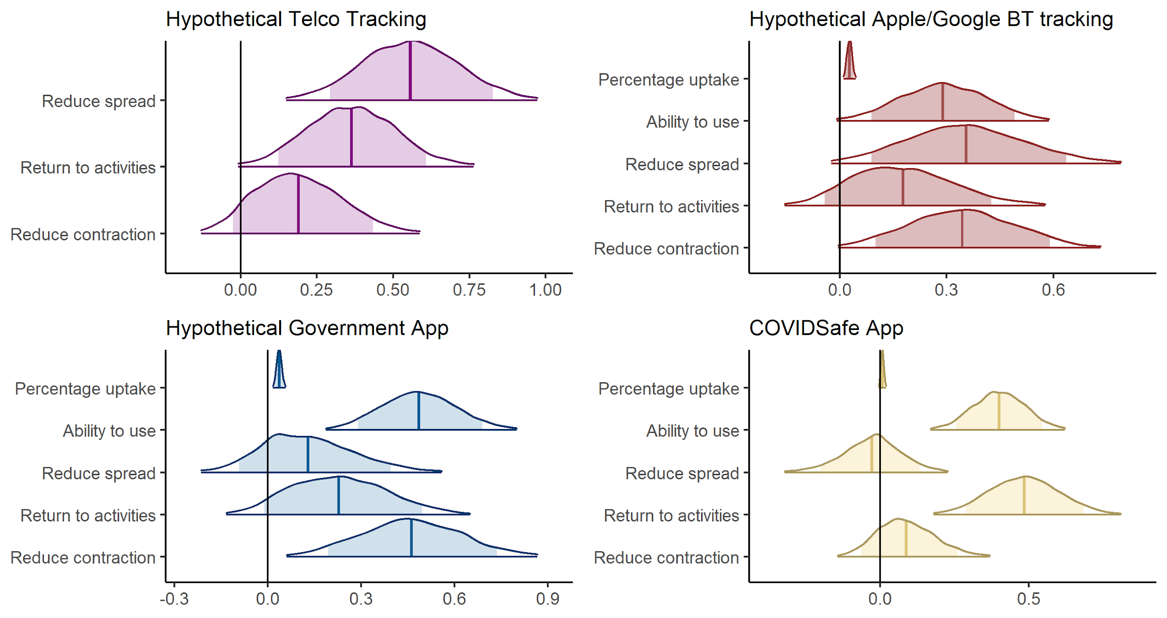
Predicting Acceptance: Perceptions of Tracking Effectiveness
Perceptions of Tracking Effectiveness
Notes:
Ability to use app always predicted uptake.
Percentage uptake also likely has an effect.
Otherwise results mixed, but data generally shows that attitudes that the app are moer effective

Slide 39
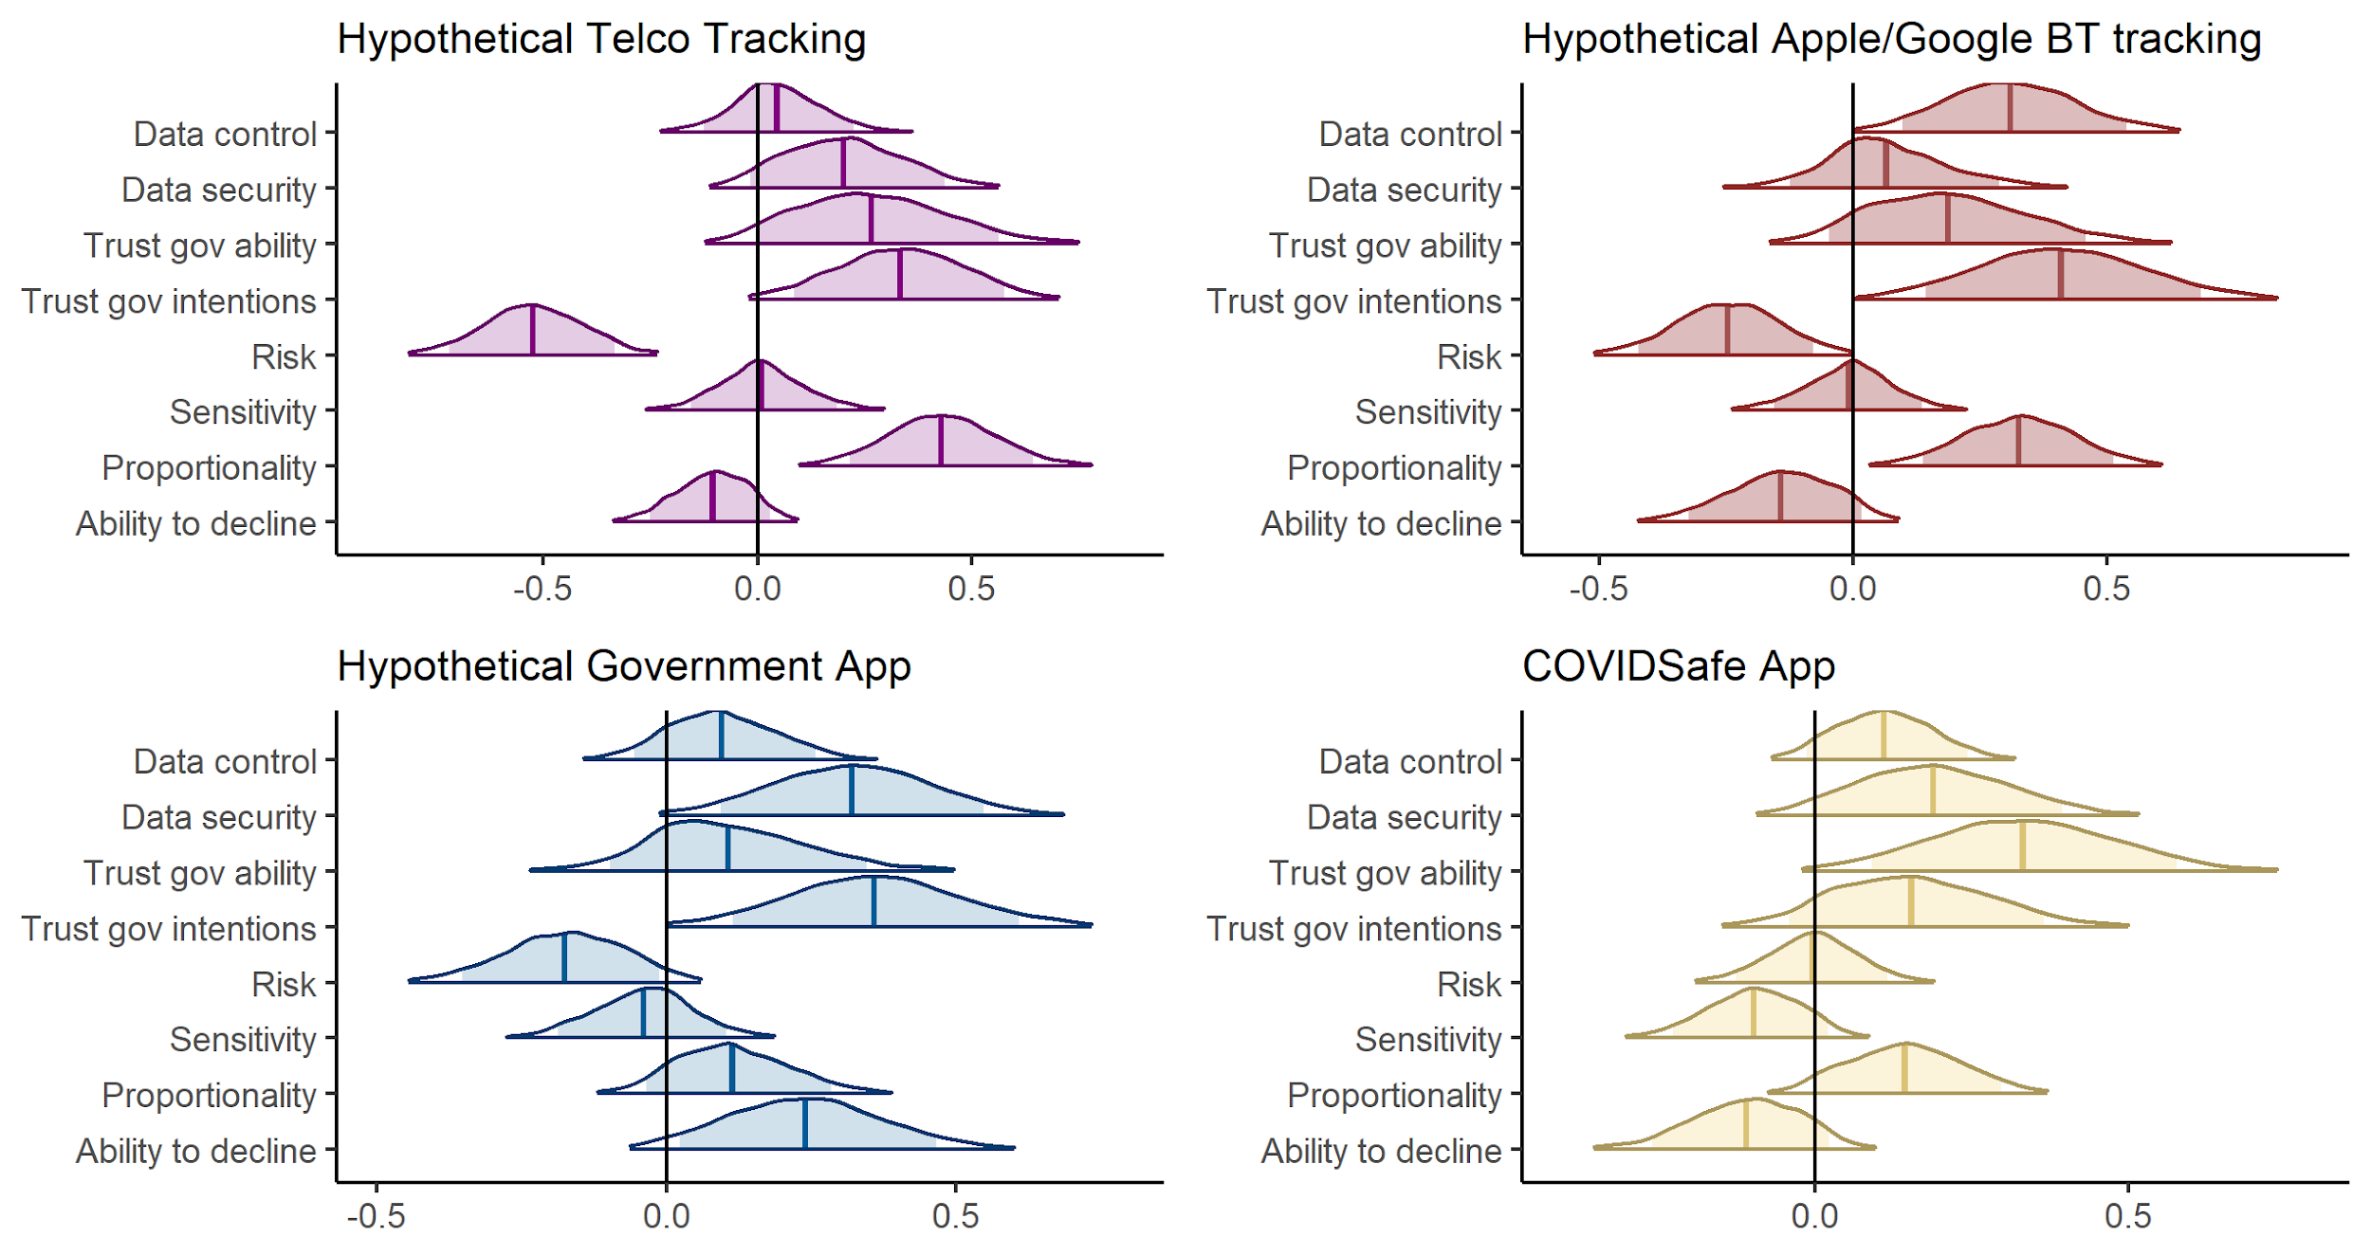
Predicting Acceptance: Perceptions of Tracking Privacy
Perceptions of Tracking Privacy
Notes:
For COVIDSafe only trust in government ability
For others risk and trust government intentions.

Slide 40
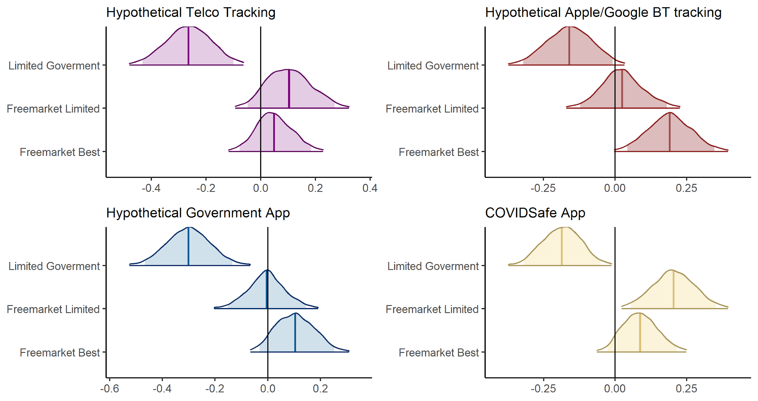
Predicting Acceptance: Ideology
Ideology
Limited Government: “The government should interfere with the lives of citizens as little as possible”
Notes:
The government should interfere with the lives of citizens as little as possible.
The free market system may be efficient for resource allocation but it is limited in its capacity to promote social justice.
An economic system based on free markets unrestrained by government interference automatically works best to meet human needs.

Slide 41
Predicting Acceptance: Summary
Demographics:
Increase in both age and education predicted greater likelihood of COVIDSafe uptake
Hypothetical scenarios - no demographic predictors (except phone use - not surprising!)
Perceptions and experience of COVID-19 pandemic:
Very few predictors. Except:
Knowing others that were COVID+ predicted greater likelihood of COVIDSafe uptake
Perceptions of Tracking Technology Effectiveness:
Only ability to use tracking technology predicted greater likelihood in all scenarios.
Otherwise mixed results. But, overall, more belief in tracking effectiveness -> more likelihood of uptake.
Perceptions of Tracking Technology Privacy:
Very few systematic predictors across scenarios.
Trust in government intentions and risk of harm were both predictors in hypothetical scenarios, but not for COVIDSafe.
Trust in government to respect privacy only predictor of COVIDSafe app uptake
Ideology:
In all scenarios, support for limited Government predicted less likelihood of supporting/using COVID-19 tracking.
Summary

Slide 42
OVERALL SUMMARY
Importance of rapid science.
Need for rapid contact tracing.
Difference between predicting actual behaviour and hypothetical intentions.
Age, education, ideology, smartphone use, trust in government ability, ability to use app, & belief that app will let us return to activities all predict COVIDSafe uptake.

Slide 43

THANKS!
Collaborators
Stephan Lewandowsky
Yoshi Kashima
Daniel Little
Amy Perfors
Lewis Mitchell
Nic Geard
Martin Tomko

Slide 44
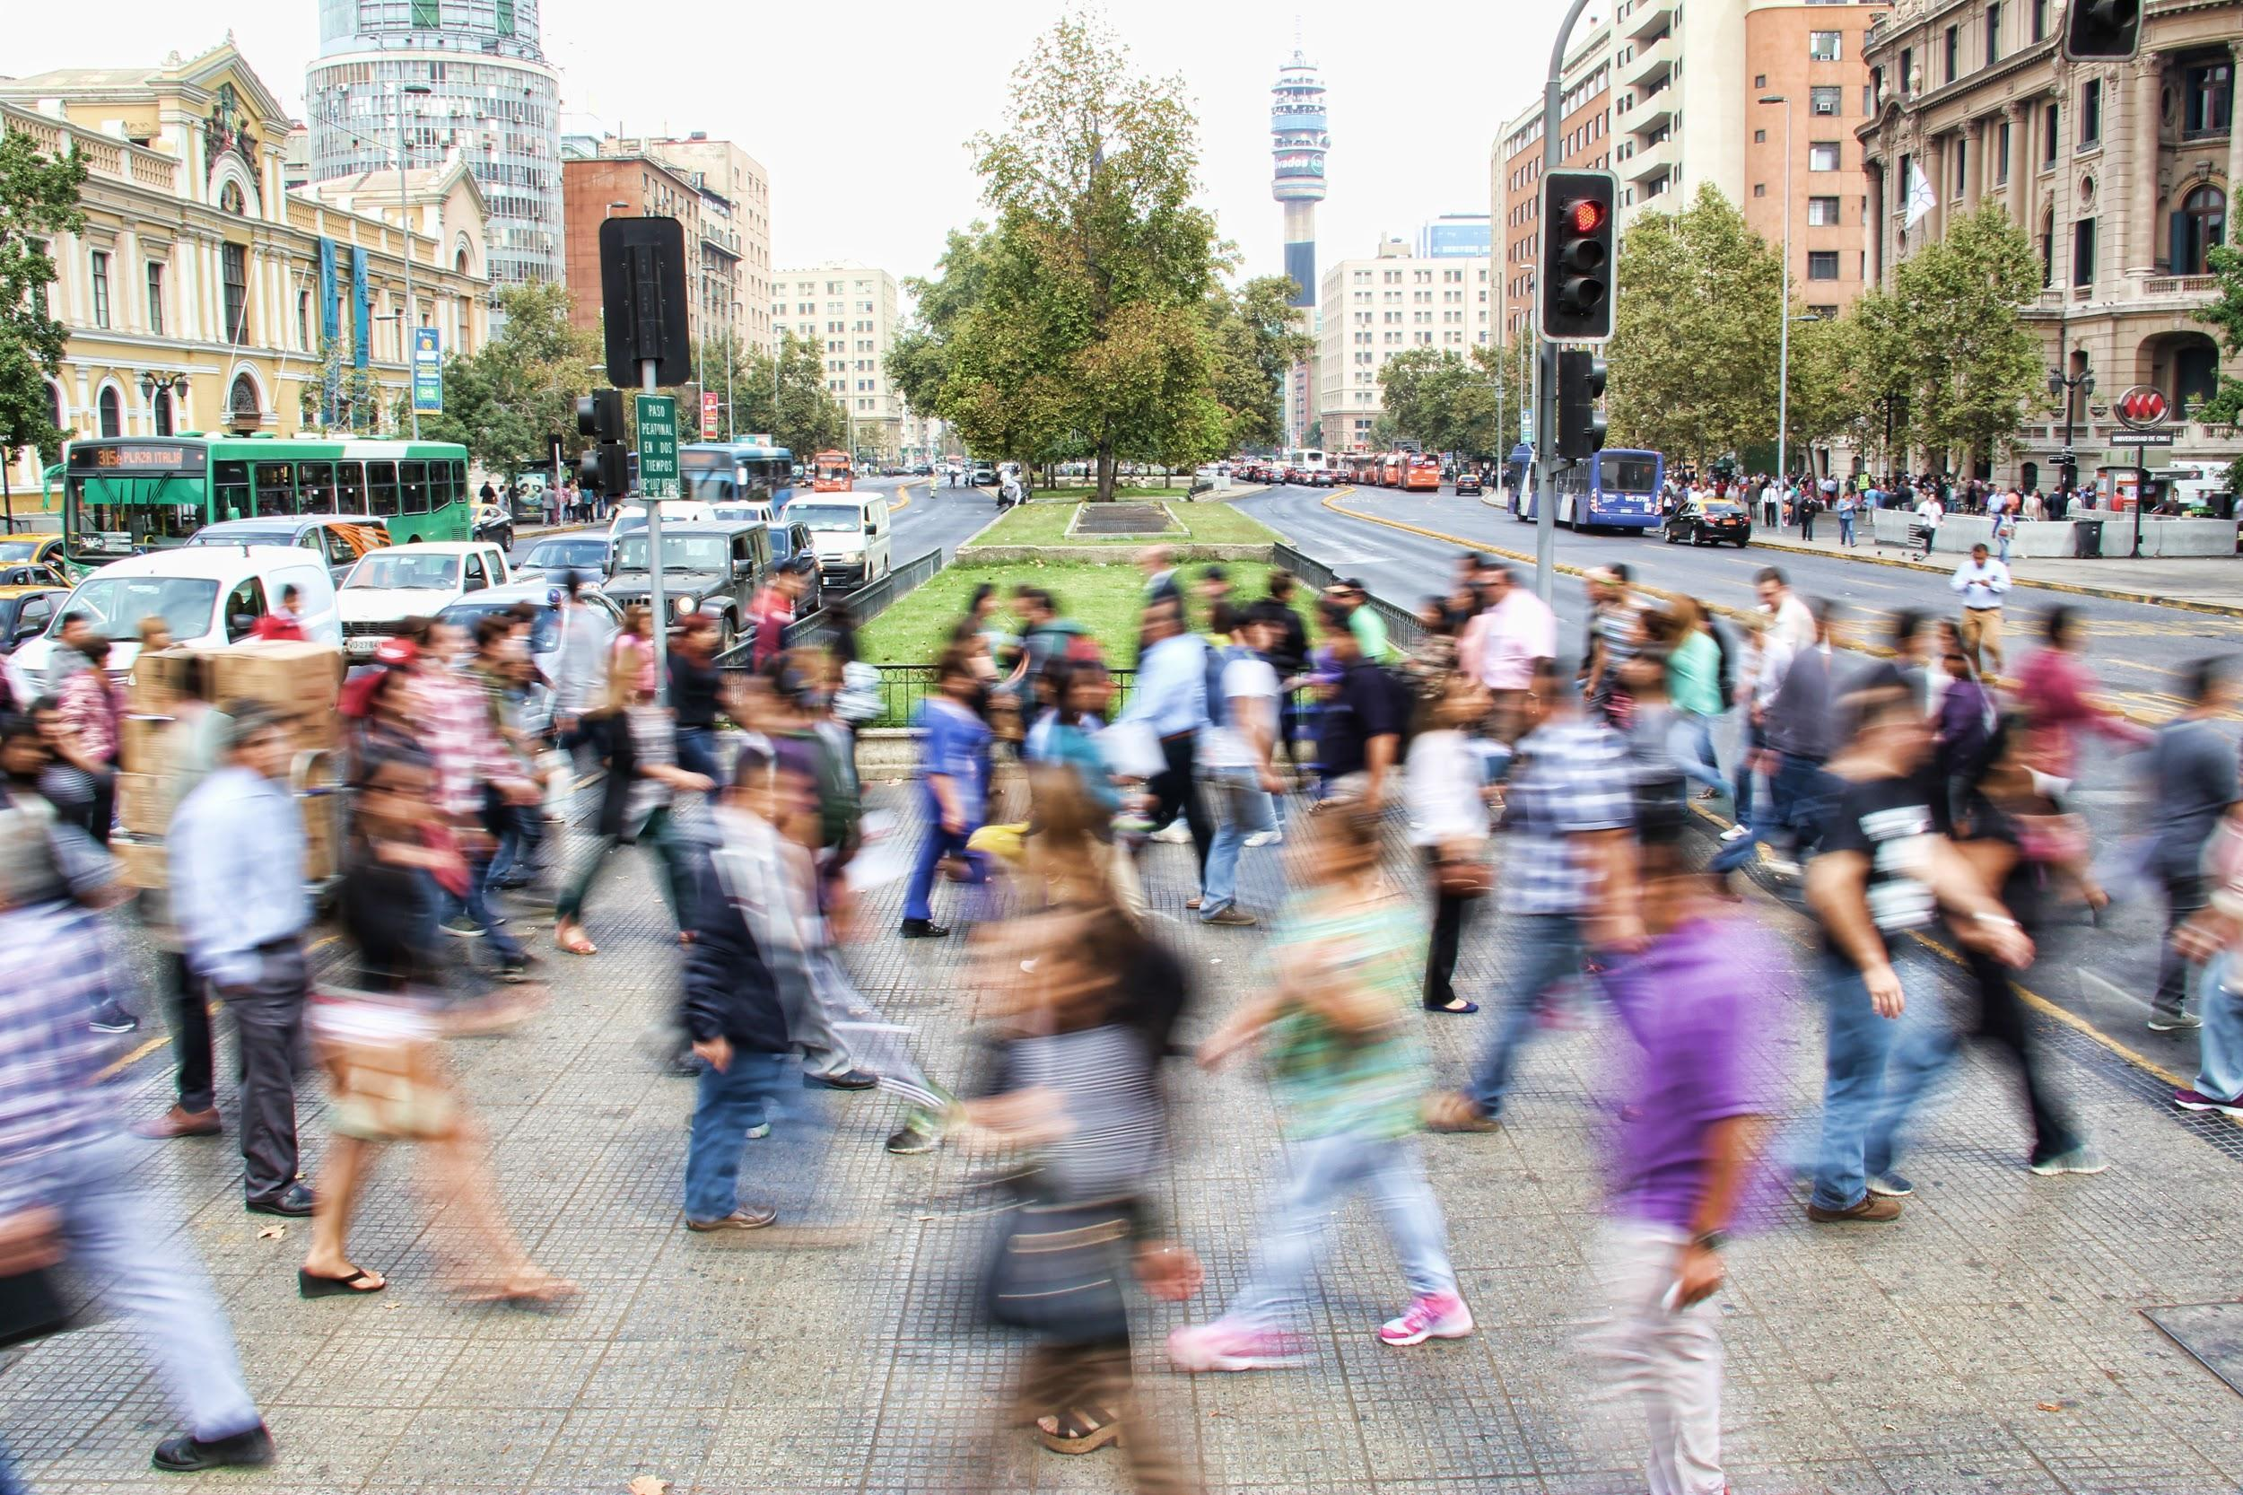
QUESTIONS?

Slide 45
Tracking Scenarios
Mandatory government mobile network tracking (waves 1 and 2)
“The COVID-19 pandemic has rapidly become a worldwide threat. Containing the virus’ spread is essential to minimize the impact on the healthcare system, the economy, and save many lives. The Australian Government might consider using phone tracking data supplied by telecommunication companies to identify and contact those who may have been exposed to people with COVID-19. This would help reduce community spread by identifying those most at risk and allowing health services to be appropriately targeted. All people using a mobile phone would be included in the project, with no possibility to opt-out. Data would be stored in an encrypted format on a secure server accessible only to the Australian Government who may use the data to locate people who were violating lockdown orders and enforce them with fines and arrests where necessary. Data would also be used to inform the appropriate public health response and to contact those who might have been exposed to COVID-19, and individual quarantine orders could be made on the basis of this data.”

Slide 46
Tracking Scenarios
Voluntary government Bluetooth tracking (waves 1 and 2)
“The COVID-19 pandemic has rapidly become a worldwide threat. Containing the virus’ spread is essential to minimize the impact on the healthcare system, the economy, and save many lives. The Australian Government might consider using smartphone tracking data to identify and contact those who may have been exposed to people with COVID-19. This would help reduce community spread by identifying those most at risk and allowing health services to be appropriately targeted. Only people that downloaded a government app and agreed to be tracked and contacted would be included in the project. The more people that download and use this app the more effectively the Government would be able to contain the spread of COVID-19. Data would be stored in an encrypted format on a secure server accessible only to the Australian Government. Data would only be used to contact those who might have been exposed to COVID-19.”

Slide 47
Tracking Scenarios
Apple/Google Bluetooth API tracking (wave 2 only)
“The COVID-19 pandemic has rapidly become a worldwide threat. Containing the virus’ spread is essential to minimize the impact on the healthcare system, the economy, and save many lives. Apple and Google have proposed adding a contact tracing capability to existing smartphones to help inform people if they have been exposed to others with COVID-19. This would help reduce community spread of COVID-19 by allowing people to voluntarily self-isolate. When two people are near each other, their phones would connect via Bluetooth. If a person is later identified as being infected, the people they have been in close proximity to are then notified without the government knowing who they are. The use of this contact tracing capability would be completely voluntary. People who are notified would not be informed who had tested positive.”

Slide 48
Tracking Scenarios
COVIDSafe government Bluetooth tracking (wave 3 only)
“The COVID-19 pandemic has rapidly become a worldwide threat. Containing the virus’ spread is essential to minimise the impact on the healthcare system, the economy, and save many lives. The Australian Government has recently released the COVIDSafe smartphone app to help identify and contact those who may have been exposed to people with COVID-19. The use of this app is completely voluntary, but the government has explicitly stated that easing social distancing restrictions depends at least in part on the degree of community uptake of this voluntary app. This is because, the more people that download and use this app the more effectively it will help to contain the spread of COVID-19. The app works with bluetooth and no location data is collected: when two people are near each other, their phones connect and keep a record of all these connections. If a person is later identified as being infected, that person may voluntarily upload their bluetooth contacts to a secure server accessible only to the Health Department of the Australian Government. This data would only be used by the Health Department of the Australian Government to contact those who might have been exposed to COVID-19.”

